Slide 1
The Utilization of Polar Grid Resources to Analyze, Process, and Display Data from the National Data Buoy Center
Bryce Carmichael
Lee Godley III
Diaminatou Goudiaby
Unquiea Wade
Mentor: Dr. Eric Akers

Slide 2
OVERVIEW
Abstract
Background
National Buoy Data Center
Condor
Gnuplot
Results
Conclusion
Future Work
References
Acknowledgements

Slide 3
ABSTRACT
This project presents an example of a real world problem with data collection and processing. In order to solve this dilemma, cluster research was conducted to construct a model to serve as a base for a super computing pool, allocating data to a central location, and examining the data from the National Data Buoy Center. The model serves as a standard for solving real world problems using resources such as Condor, which utilizes a six hundred plus core cluster and two computer laboratories on Elizabeth City State University’s campus. In order to standardize the model, major components must be accessed using Condor. These components include the allocation of data to a central location, the access of data from that location, the distribution of various jobs to both the laboratory and cluster computers, and the automatic installation of Gnuplot onto a computer.

Slide 4
NATIONAL DATA BUOY CENTER
Agency within the National Weather Service (NWS)
Deploys buoys in locations for meteorological and environmental observations
Stations measure sea surface temperature, average wave period, dominant wave period, and wave height
Measurements are submitted through Condor for processing and graphically visualized with GNUplot for analyzing purposes

Slide 5
CONDOR
Free-ware, software system
Developed at the University of Wisconsin-Madison.
Implements the power of a cluster on a network.
Able to perform data collection and processing.

Slide 6
GNUPLOT
Most widely used program to plot and visualize data
It is an open source program that runs through the command-line
Shows the statistical data of buoys from the NDBC.
The program is capable of producing high-quality, publication graphics and deals with large data sets.

Slide 7
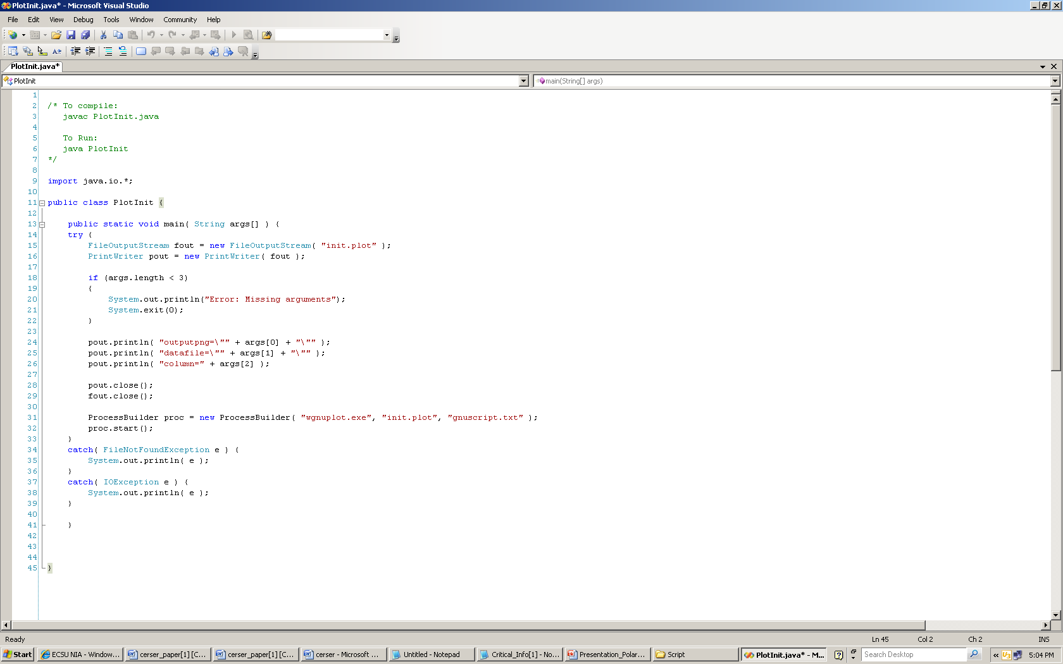
Initial Java Program

Slide 8
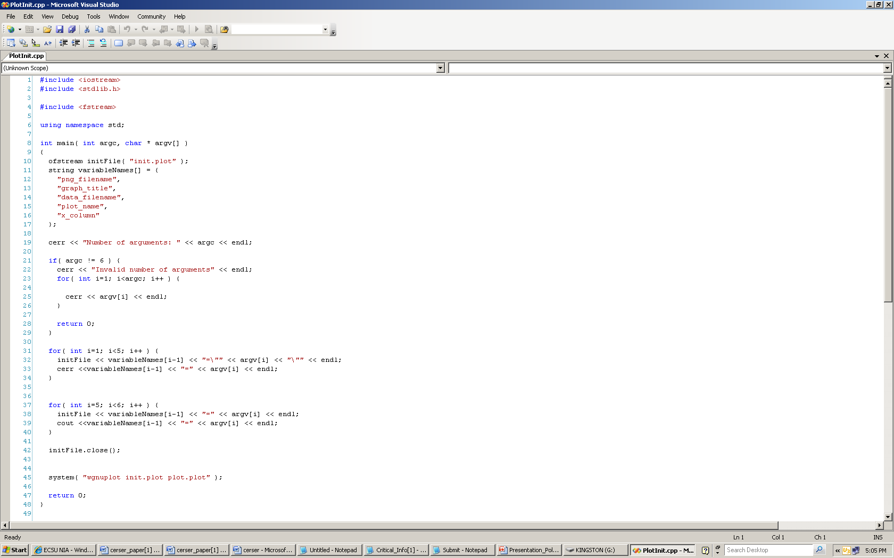
New C++ Program

Slide 9
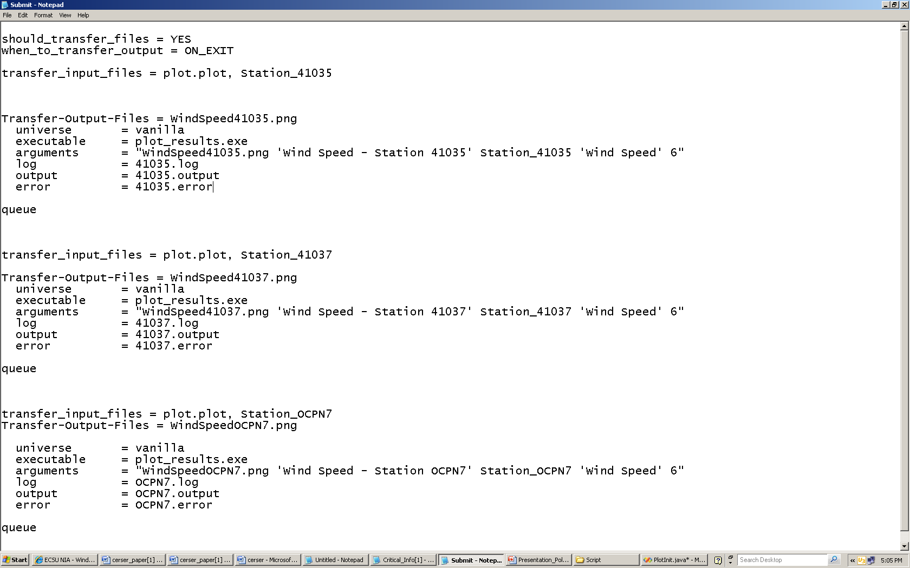
Submission File

Slide 10
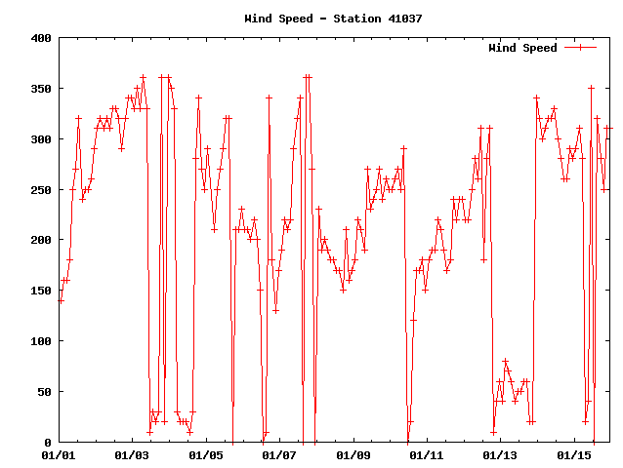
RESULTS

Slide 11
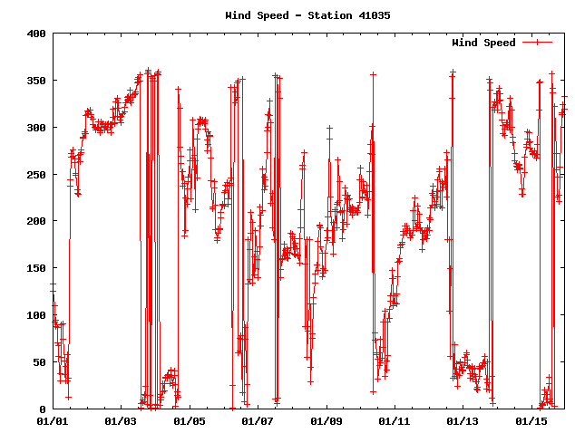
RESULTS

Slide 12
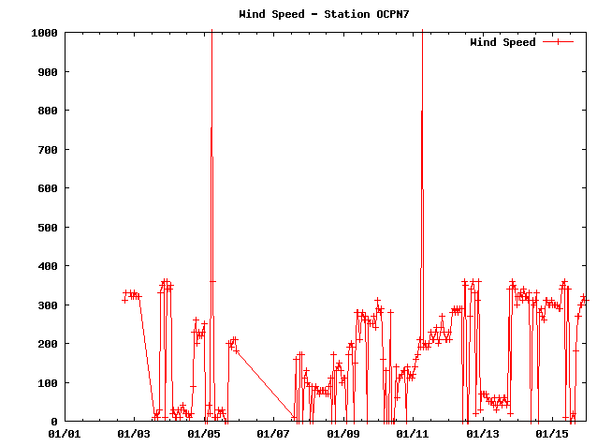
RESULTS

Slide 13
RESULTS
-- Submitter: cerser-imac-1 : <10.24.5.55:1030> : cerser-imac-1
ID OWNER SUBMITTED RUN_TIME ST PRI SIZE CMD
25.0 PolarGrid Admi 4/8 15:06 0+00:00:15 R 0 0.7 plot_results.exe
26.0 PolarGrid Admi 4/8 15:06 0+00:00:20 R 0 0.7 plot_results.exe
27.0 PolarGrid Admi 4/8 15:06 0+00:00:00 I 0 0.7 plot_results.exe
3 jobs; 1 idle, 2 running, 0 held

Slide 14
RESULTS
$ /cygdrive/c/condor/bin/condor_q
-- Submitter: cerser-imac-1 : <10.24.5.55:1030> : cerser-imac-1
ID OWNER SUBMITTED RUN_TIME ST PRI SIZE CMD
0 jobs; 0 idle, 0 running, 0 held

Slide 15
CONCLUSION
The results from the research project yield evidence of successful completion of solving our real world problem. Once the program was written efficiently, the jobs were rightfully submitted to Condor, processed, and plotted through gnuplot. This endeavor opens the door to greater data submission and more efficient plotting.

Slide 16
FUTURE WORK
Find and solve the incompatibility issues between the java universe and Condor on the Mac OSX computers.
Every C++ program submitted should run successfully within seconds.
Making Condor more efficient within our workstations.
Software packages will be researched to see if there are more applicable packages other than GNUPlot that can be used to graph data.

Slide 17
REFERENCES
Z. Juhasz, Distributed and Parallel Systems: Cluster and Grid Computing (The Springer International Series in Engineering and Computer Science). New York, NY: Springer, Inc., 2005, pp. 34–57.
H. Bauke, High Performance Cluster Computing: Architectures and Systems, Vol. 1. Upper Saddle River, NJ: Prentice Hall PTR, 1999, pp. 320–339.
R. Buyya, Cluster Computing. Hauppauge, NY: Nova Science Publishers, 2001, pp. 23–45.
G. Pfister, In Search of Clusters (2nd Edition). Upper Saddle River, NJ: Prentice Hall PTR, 1997, pp. 67–89, 234-277.
“Condor Project Homepage”, Retrieved from the World Wide Web http://www.cs.wisc.edu/condor/
“Building a Linux Cluster on a Budget”, Retrieved from the World Wide Web http://www.linux.com/articles/49654/
“GNU Plot Homepage”, Retrieved from the World Wide Web http://www.gnuplot.info/

Slide 18
QUESTIONS
?

